Slide 1

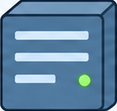





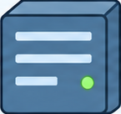

Web Application Architecture
Private network
Redis Cache
App Server 1
Message Queue
Worker
PostgreSQL Primary
PostgreSQL Replica
Users
CDN
Load Balancer
replication
PostgreSQL Primary
PostgreSQL Replica
App Server 2
Object Storage
Object Storage

